Slide 1
json2puml
Make data visible and understandable
Jens Fudickar, April 2022

Slide 2
API’s and DATA
Working with API’s leads to working with JSON data
A typical answer of a REST API call can look like this:
How to visualize / understand this ?
{"height":{"meters":70,"feet":229.6},"diameter":{"meters":3.7,"feet":12},"mass":{"kg":549054,"lb":1207920},"first_stage":{"thrust_sea_level":{"kN":7607,"lbf":1710000},"thrust_vacuum":{"kN":8227,"lbf":1849500},"reusable":true,"engines":9,"fuel_amount_tons":385,"burn_time_sec":162},"second_stage":{"thrust":{"kN":934,"lbf":210000},"payloads":{"composite_fairing":{"height":{"meters":13.1,"feet":43},"diameter":{"meters":5.2,"feet":17.1}},"option_1":"dragon"},"reusable":false,"engines":1,"fuel_amount_tons":90,"burn_time_sec":397},"engines":{"isp":{"sea_level":288,"vacuum":312},"thrust_sea_level":{"kN":845,"lbf":190000},"thrust_vacuum":{"kN":914,"lbf":205500},"number":9,"type":"merlin","version":"1D+","layout":"octaweb","engine_loss_max":2,"propellant_1":"liquid oxygen","propellant_2":"RP-1 kerosene","thrust_to_weight":180.1},"landing_legs":{"number":4,"material":"carbon fiber"},"payload_weights":[{"id":"leo","name":"Low Earth Orbit","kg":22800,"lb":50265},{"id":"gto","name":"Geosynchronous Transfer Orbit","kg":8300,"lb":18300},{"id":"mars","name":"Mars Orbit","kg":4020,"lb":8860}],"flickr_images":["https:\/\/farm1.staticflickr.com\/929\/28787338307_3453a11a77_b.jpg","https:\/\/farm4.staticflickr.com\/3955\/32915197674_eee74d81bb_b.jpg","https:\/\/farm1.staticflickr.com\/293\/32312415025_6841e30bf1_b.jpg","https:\/\/farm1.staticflickr.com\/623\/23660653516_5b6cb301d1_b.jpg","https:\/\/farm6.staticflickr.com\/5518\/31579784413_d853331601_b.jpg","https:\/\/farm1.staticflickr.com\/745\/32394687645_a9c54a34ef_b.jpg"],"name":"Falcon 9","type":"rocket","active":true,"stages":2,"boosters":0,"cost_per_launch":50000000,"success_rate_pct":98,"first_flight":"2010-06-04","country":"United States","company":"SpaceX","wikipedia":"https:\/\/en.wikipedia.org\/wiki\/Falcon_9","description":"Falcon 9 is a two-stage rocket designed and manufactured by SpaceX for the reliable and safe transport of satellites and the Dragon spacecraft into orbit.","id":"5e9d0d95eda69973a809d1ec"}

Slide 3
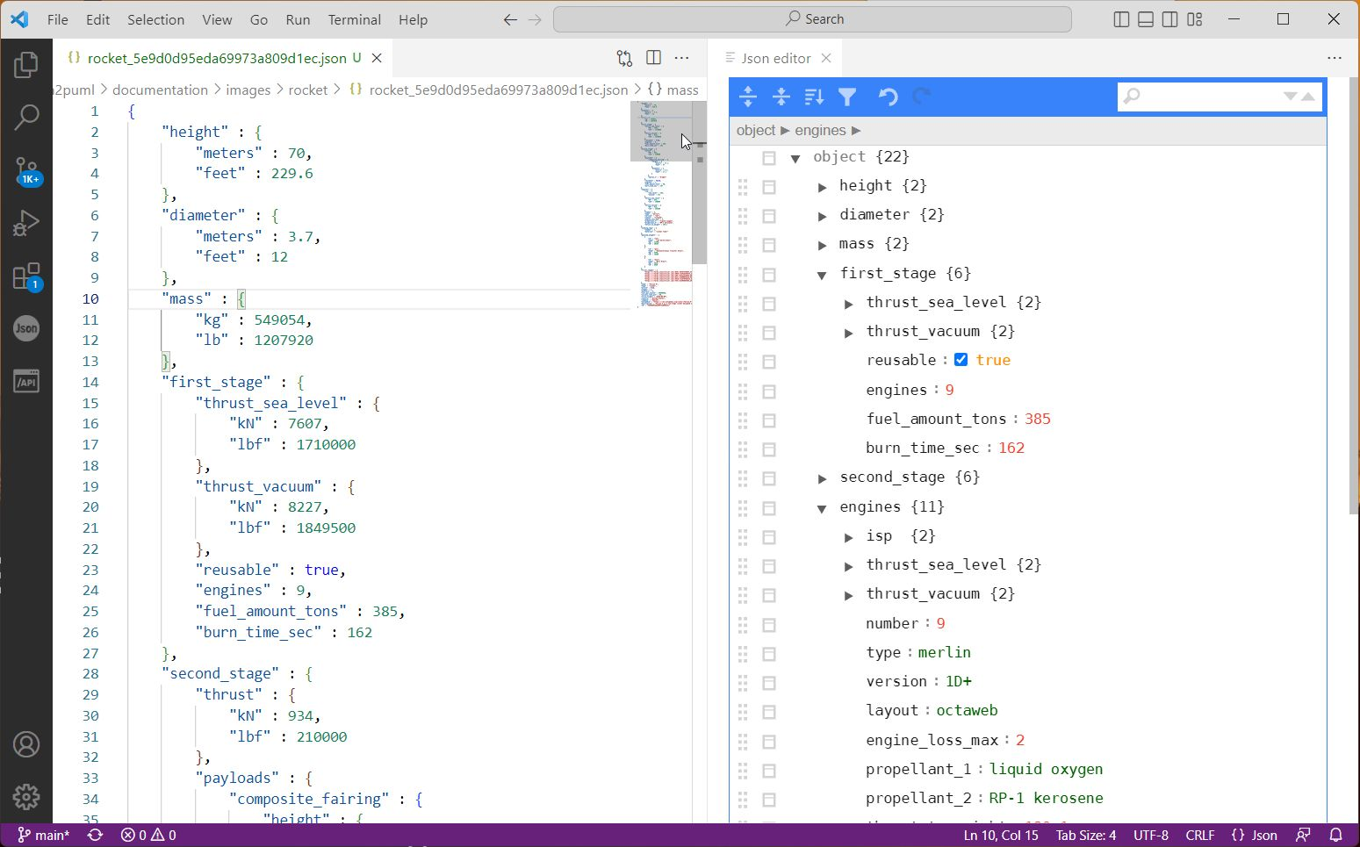
(Online) JSON Editor
This makes the live easier but it is still complex ☺

Slide 4
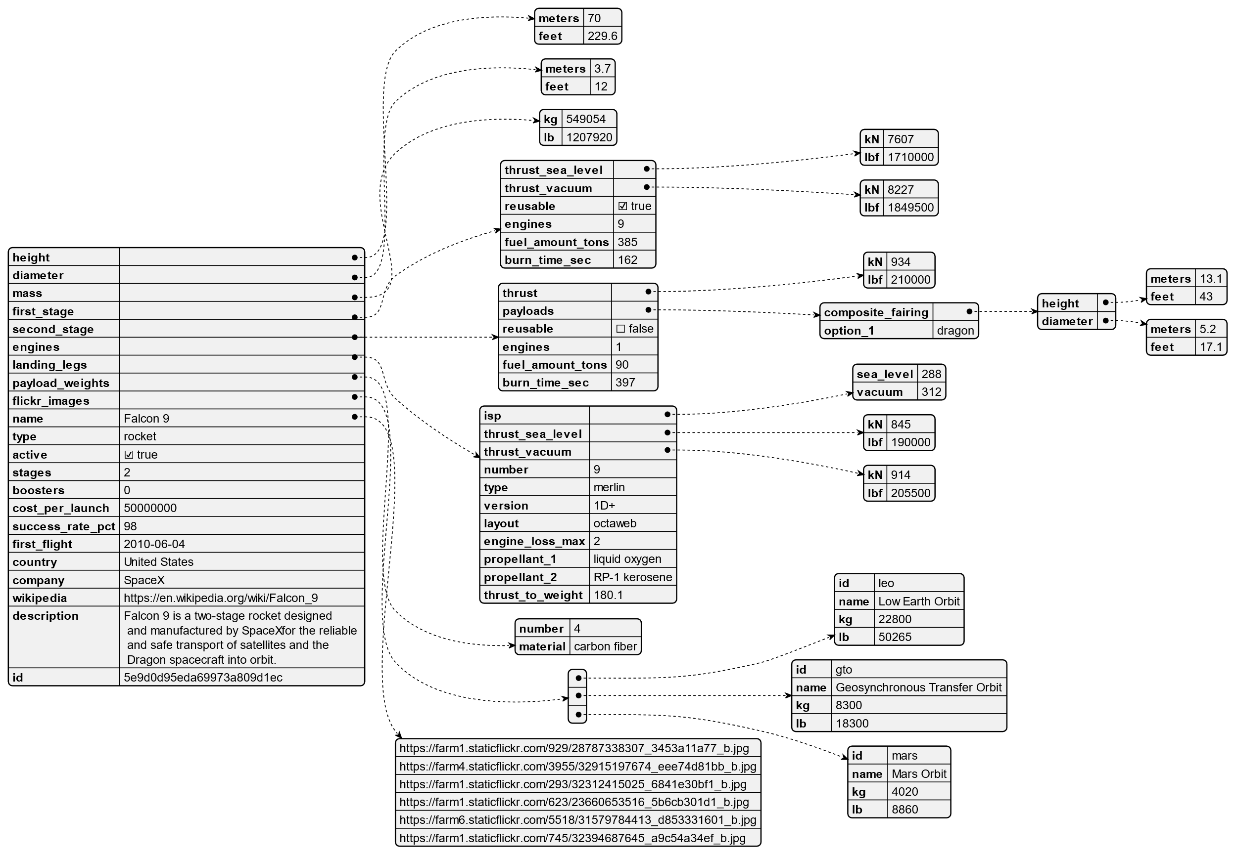
Confluence and Standard PlantUML
PlantUML supports an OOTB visualisation of JSON.
@startjson <json> @endjson
This improves also, but there is no knowledge about the data models behind

Slide 5
Drawing by Hand
It’s nice, and it’s giving you a task.
But it’s not effective, not accurate and not fast enough.
Launchpad
Landpad
Launch
Rocket
First stage
Second stage
Crew Member
Crew Member
Crew Member
Crew Member
Engines

Slide 6
One Solution: json2puml
Json2puml | allows to convert JSON data into PlantUML based diagrams.
Json2puml | has an understanding of how data is structured and simplifies and visualises the outcome.
json2puml | has the possibility to combine the JSON results of multiple API calls into one result set.
json2puml | is highly configurable to generate outcomes in different detailed levels.
json2puml | is free to use for everyone.

Slide 7
SpaceX REST API
Open Source REST API for launch, rocket, core, capsule, starlink, launchpad, and landing pad data.
https://github.com/r-spacex/SpaceX-API
What is this?
It’s an unofficial public API to receive various information about all Space X rocket launches.

Slide 8
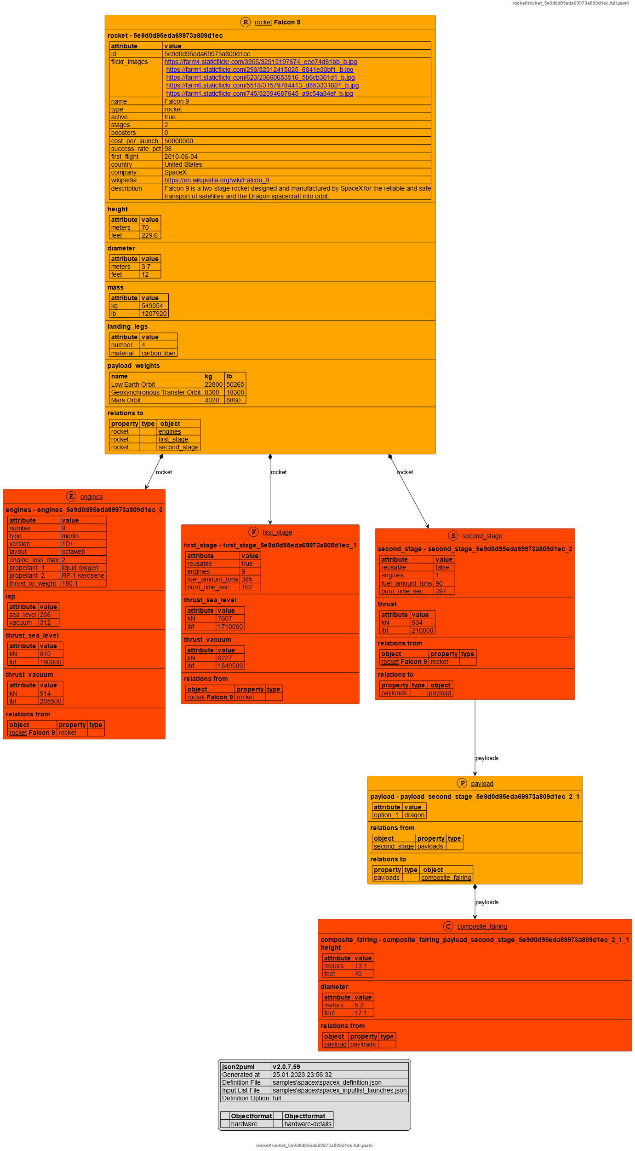
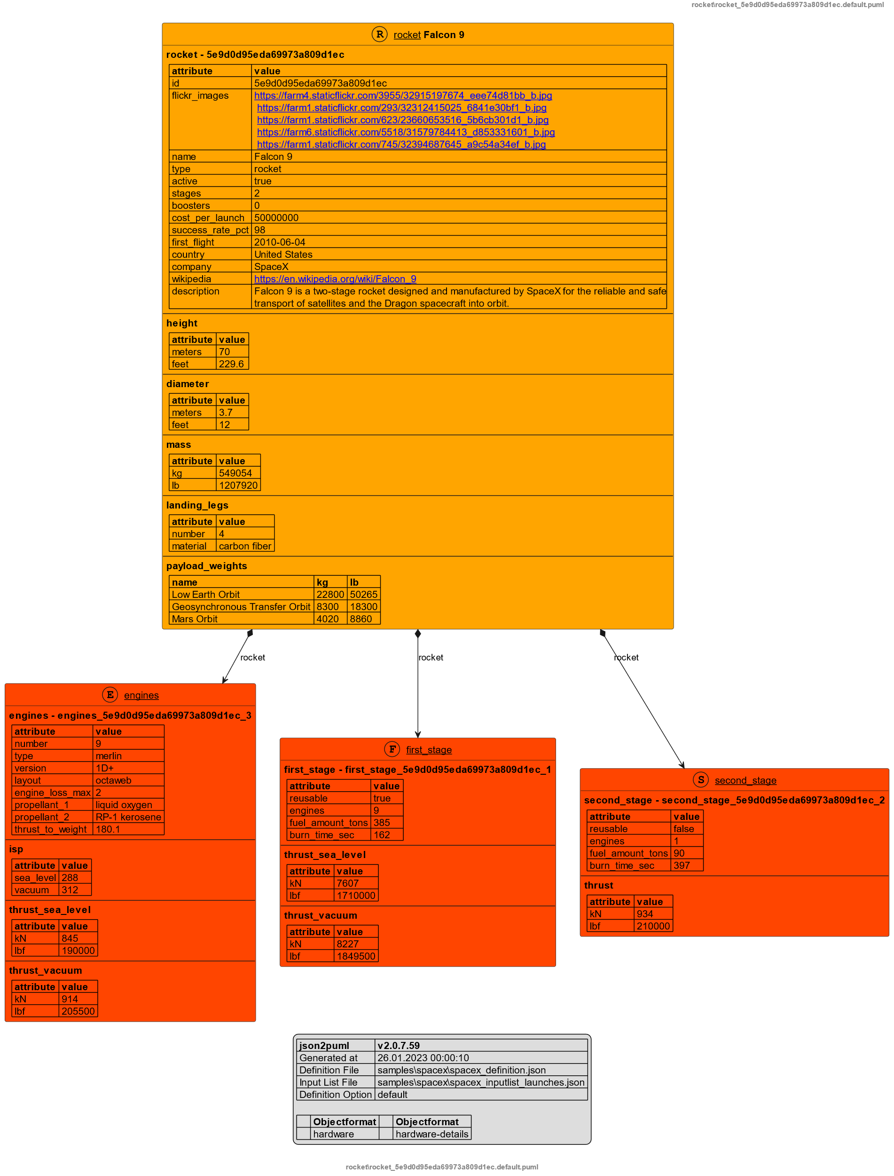
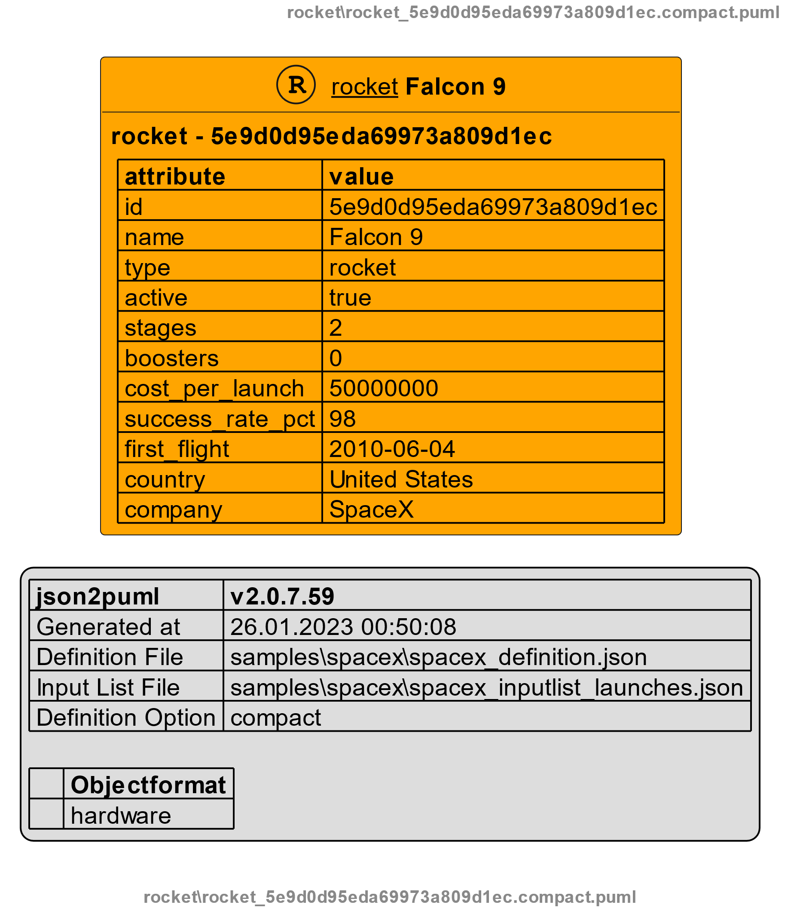
Space X API – get /rocket
One API result formatted with three different options.
Option : compact
Option : default
Option : full

Slide 9
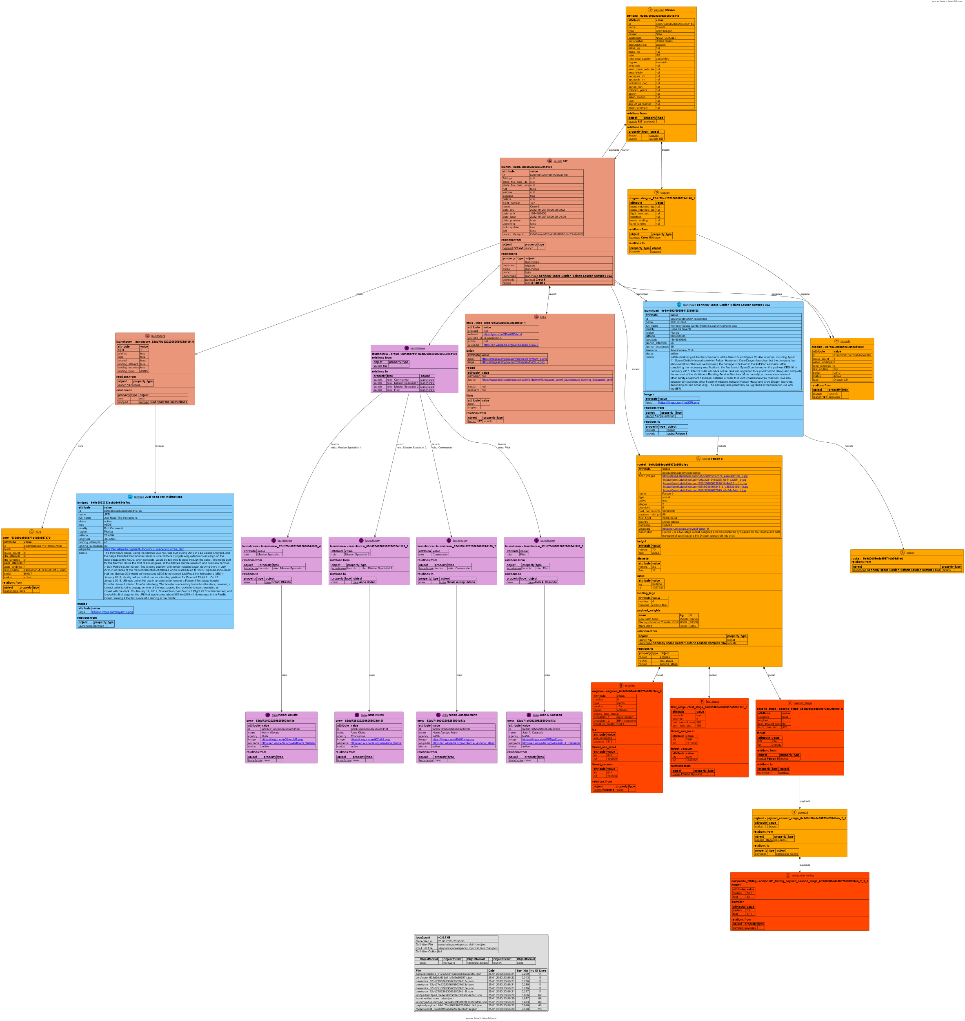
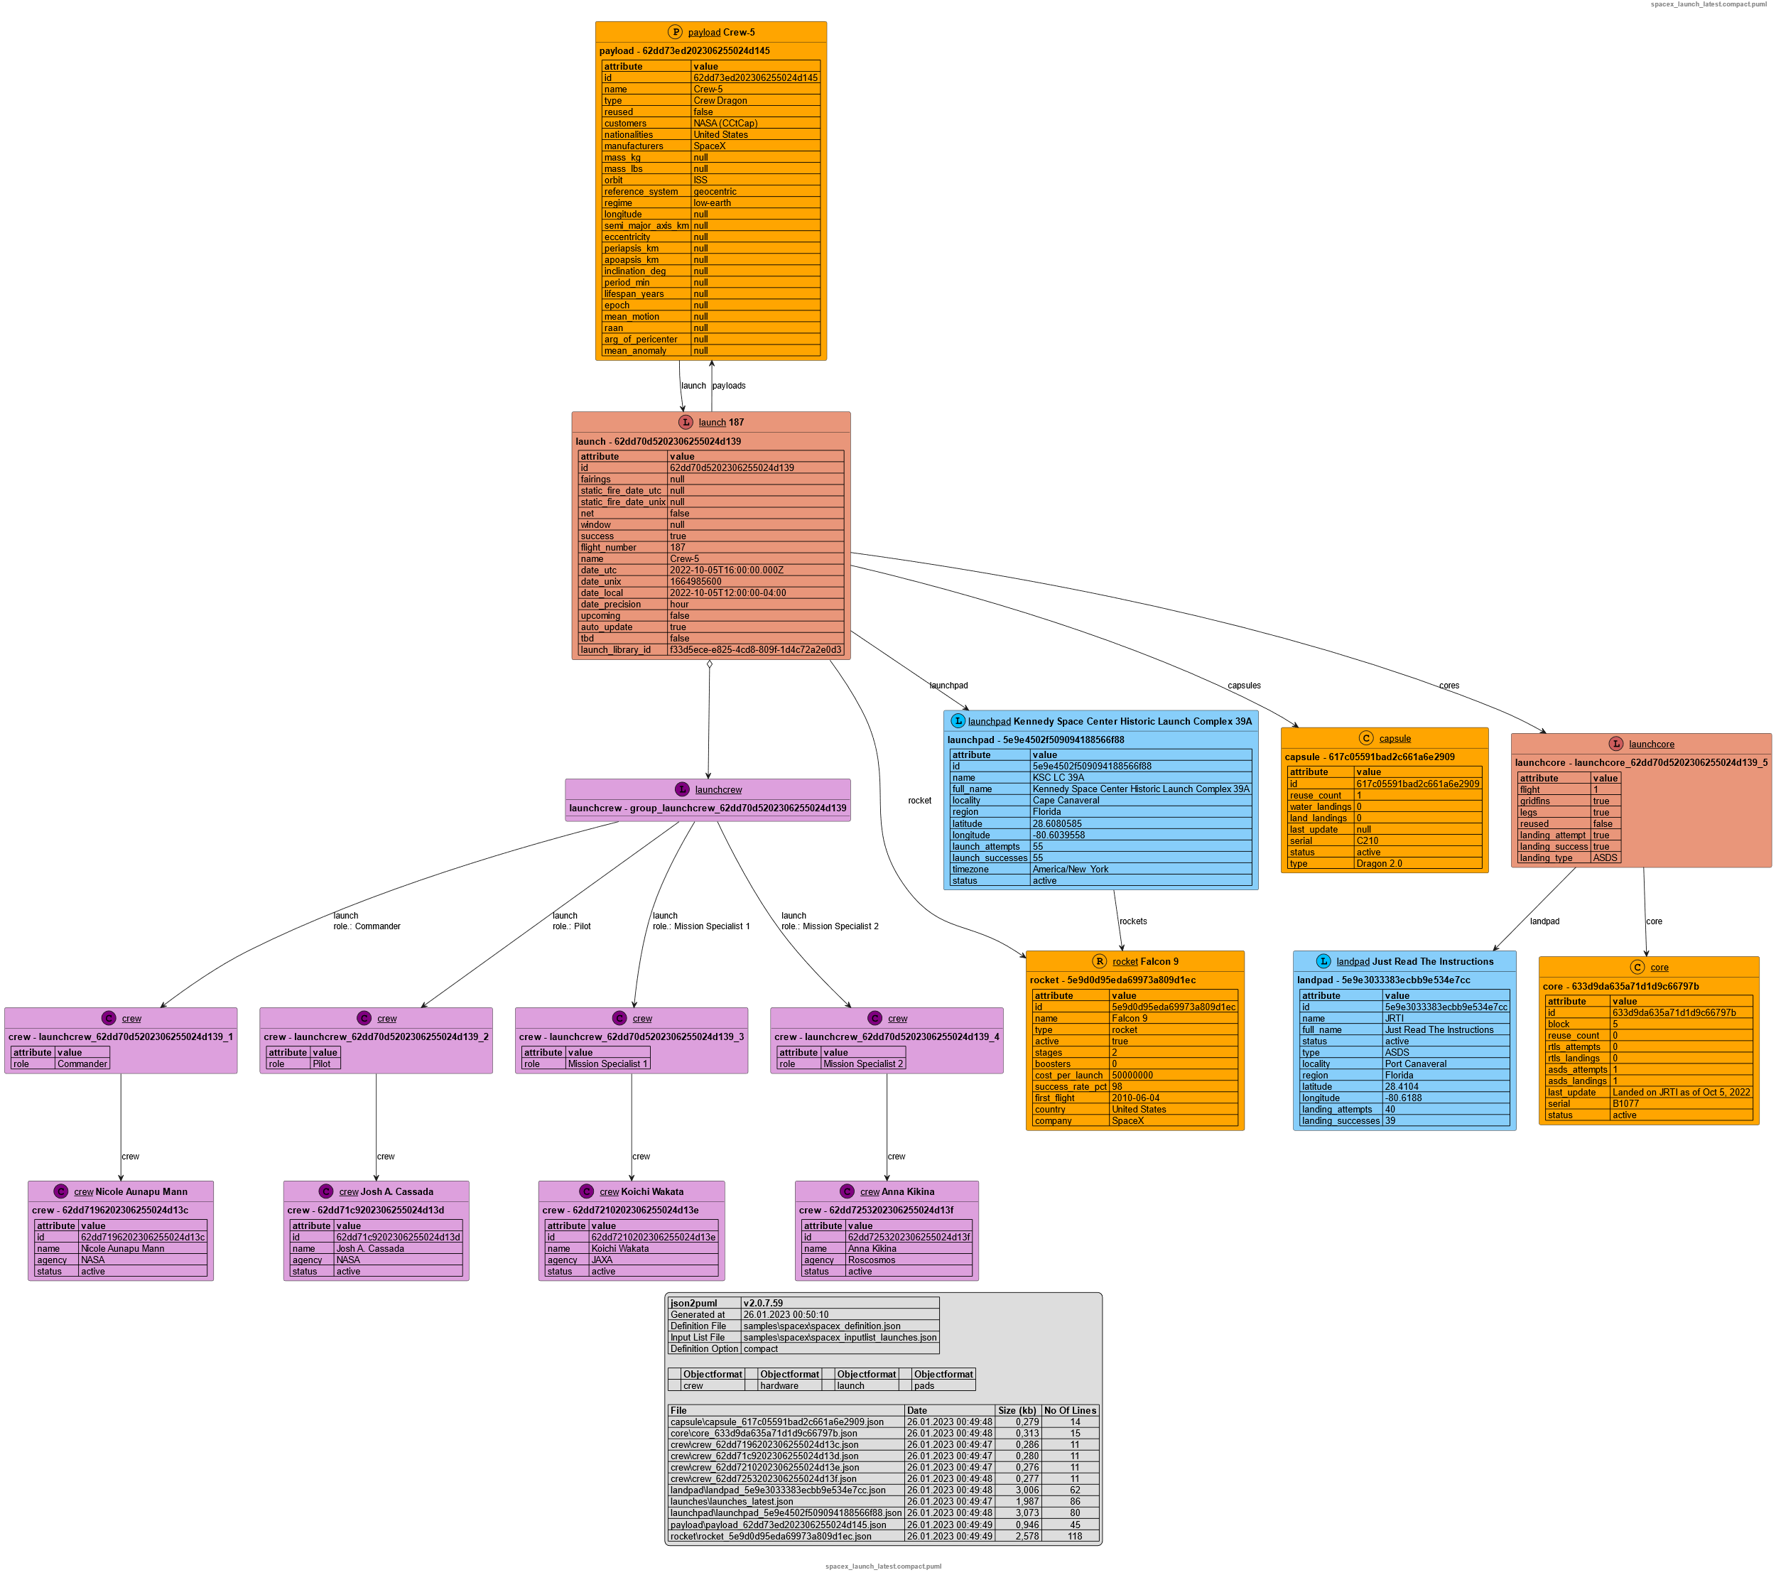
All data regarding the latest launch of a Space X rocket (8 Api’s combined)
Option : compact
Option : full

Slide 10
SWAPI - The Star Wars API
https://swapi.dev/
What is this?
The Star Wars API, or "swapi" (Swah-pee) is the world's first quantified and programmatically-accessible data source for all the data from the Star Wars canon universe!
We've taken all the rich contextual stuff from the universe and formatted into something easier to consume with software. Then we went and stuck an API on the front so you can access it all!

Slide 11
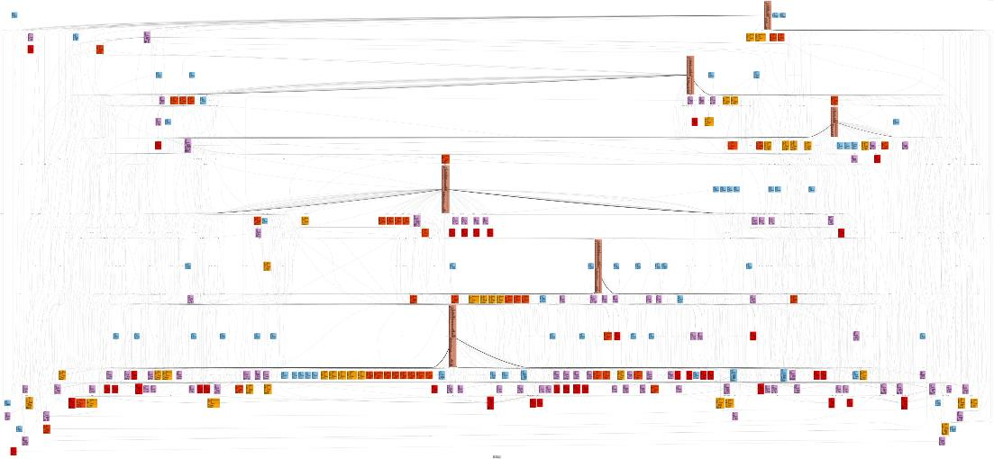
All Data 6 Films, 82 Persons, 60 Planets, 37 Species, 36 Star ships, 39 Vehicles

Slide 12
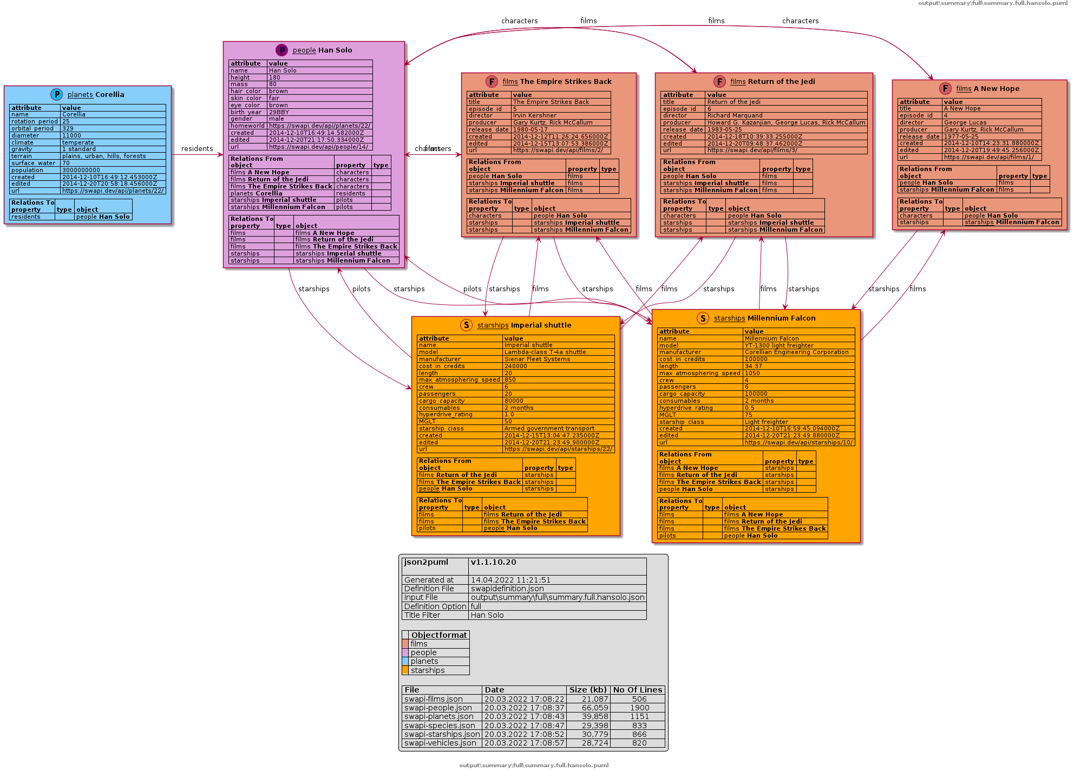
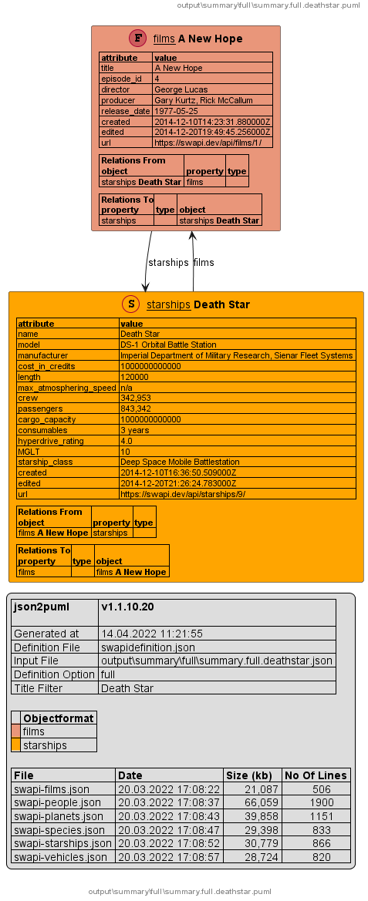
Examples
/titlefilter:“Han Solo”
/titlefilter:“Death Star”

Slide 13
How is it working
json2puml | Has three main components which can be combined
 | Fetch data from a defined set of API’s using curl. (Optional) Convert the JSON data into a PlantUml script. Convert the PlantUml script into a SVG or PNG file using PlantUml command line utility.
json2puml | can automate the fetching of data by using data from an API result as an input criteria for the next API call. E.g. Using the SpaceX API the get /launch result includes the ID of the used rocket. This ID can be used for the next get /rocket call.

Slide 14
Operating Systems
json2puml | can be used on MS Windows and on Linux.
 | For Linux there are plain executables and docker container available.
json2puml | can run as command line tool or as a service application answering on http based REST calls.

Slide 15
Where can you find it:
It’s published on Github.com under a GPLv3 license.
https://github.com/jfudickar/json2puml

